Slide 1


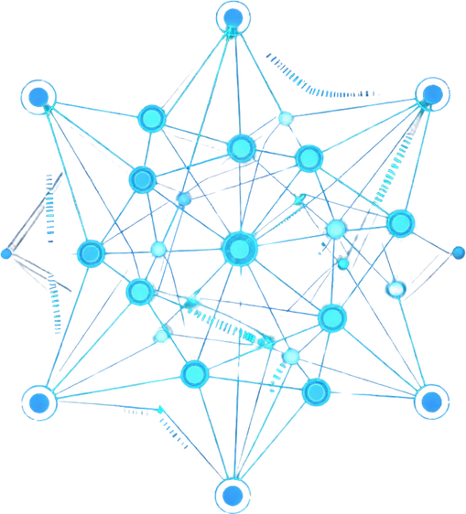

AIOps · Observability · Real-Time Intelligence
PAGE 01
CORTEX
Causal Incident Fabric for Intelligent Alert Filtering
EXPLORE CORTEX
Transform 500 Alerts → 3 Incidents → 1 Root Cause

Slide 2
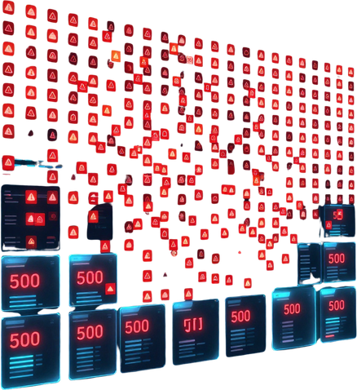
Thynk Unlimited
PAGE 02
The Problem:
Alert Fatigue
🚨 500+ alerts fire every hour — only 1 real problem exists
⏱ Engineers spend 3–4 hrs chasing symptoms, not root causes
🔇 Critical failures get buried in notification noise
📉 Mean Time to Resolve (MTTR) skyrockets under alert storms
💸 Every delayed response = downtime cost + engineer burnout
hello@reallygreatsite.com

Slide 3
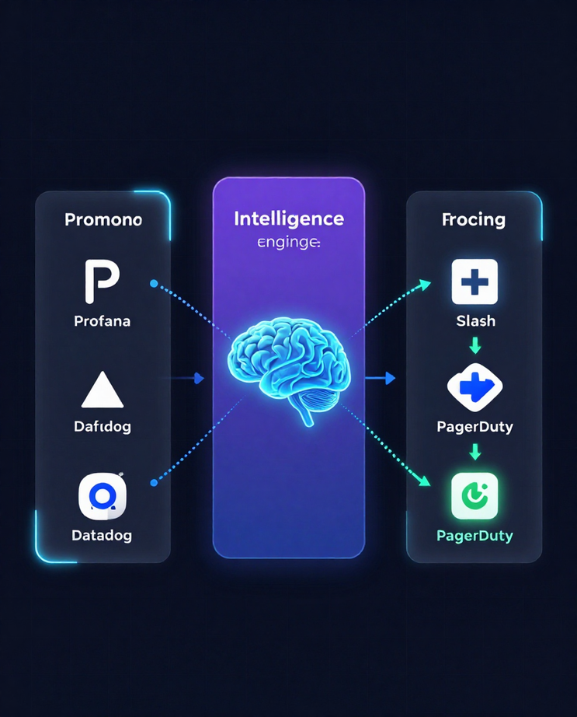
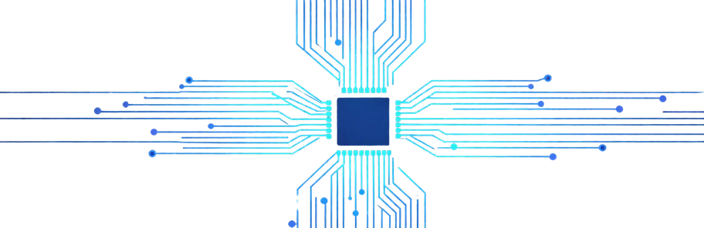
CORTEX — AIOps Incident Fabric
PAGE 03
The Solution: CORTEX
CORTEX is the intelligent middleware layer between chaos and clarity.
📥 INPUTS — Prometheus · Grafana · Datadog · Zabbix
🧠 CORTEX — Correlates · Clusters · Reasons · Decides
📤 OUTPUTS — Slack · Discord · PagerDuty · Dashboard
Not a filter. Not a deduplicator.
CORTEX asks: "Are these alerts symptoms of the same failure?"
Result: 500 raw alerts → 3 actionable incidents.
cortex-engine · FastAPI · Python · Redis · WebSockets

Slide 4
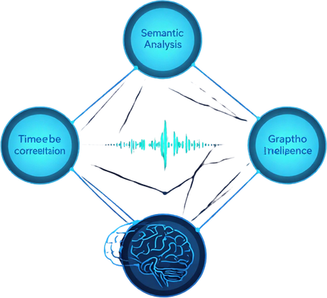

CORTEX
PAGE 04
How CORTEX Understands Alerts
Semantic Similarity
Time Correlation
Service Relationships
Reads alert meaning, not just text.
• Sentence Transformers encode each alert into a vector
• Cosine Similarity measures how alike two alerts are
• "DB connection failed" ≈ "database unreachable"
• Groups semantically related alerts automatically
Detects bursts that happen together.
• Streaming event processing tracks alert timestamps
• Alerts within a short window are linked
• Sudden spikes = single failure event
• Filters noise from unrelated background alerts
Knows which services depend on each other.
• OpenTelemetry traces map call chains
• Service dependency graphs show upstream/downstream
• If payment fails → checkout alert is a symptom
• Pinpoints root cause, not just symptoms
cortex-monitoring.io

Slide 5
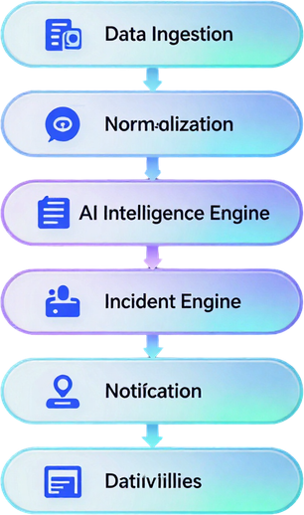
CORTEX
PAGE 5
Technical Architecture
[ INGESTION ] → Prometheus · Grafana · Datadog · Custom Webhooks
[ NORMALIZATION ] → Schema Mapping · Deduplication · Enrichment
[ INTELLIGENCE ENGINE ] → Semantic Similarity · Cosine Matching · EWMA Cooldown
[ INCIDENT ENGINE ] → Causal Graph · Root Cause Scoring · Trace Correlation
[ NOTIFICATION ] → Slack · Discord · PagerDuty · WebSockets
[ DASHBOARD ] → Real-Time UI · Incident Timeline · Service Graph
Stack: Python · FastAPI · PostgreSQL · Redis · OpenTelemetry
hello@reallygreatsite.com

Slide 6
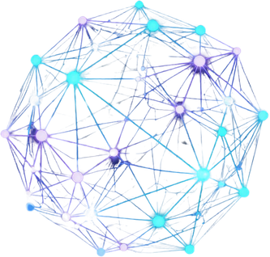
CORTEX
PAGE 06
Smart Intelligence Features
Semantic Fingerprinting
Causal Topology
Adaptive Cooldown
🔍 Converts alert text into vector embeddings using Sentence Transformers. Groups alerts by Cosine Similarity — not just exact text match. Identifies same failure across different services.
🕸️ Builds live service dependency graphs via OpenTelemetry traces. Maps upstream/downstream relationships. Pinpoints root cause node in the failure chain.
⏱️ Uses EWMA to dynamically adjust alert grouping windows. Learns from historical incident patterns. Prevents alert storms from splitting into false incidents.
Python · Sentence Transformers · OpenTelemetry · EWMA · Service Dependency Graphs

Slide 7
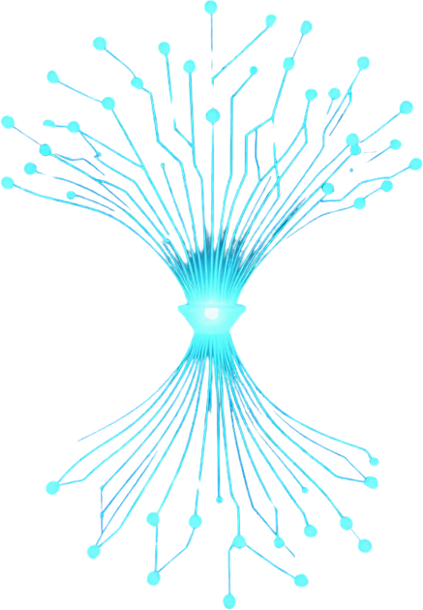
CORTEX AIOps
PAGE 07
Live Demo:
The CORTEX
Transformation
500 raw alerts ingested → Semantic clustering applied → 3 causal incidents identified → 1 probable root cause surfaced
⚡ DB connection pool exhausted → cascading API timeouts → downstream service failures. All 500 alerts: symptoms of ONE failure.
Time to root cause: 4 seconds. Without CORTEX: 2+ hours.
cortex-demo.reallygreatsite.com | github.com/cortex-aiops

Slide 8
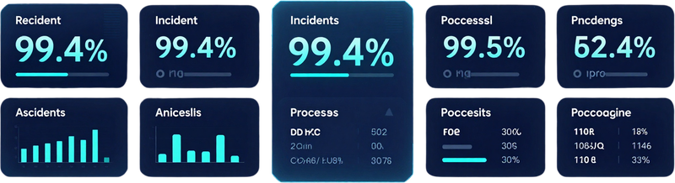
Thynk Unlimited
PAGE 08
Dashboard & Impact
📊 CORTEX Live Metrics
🔴 Alerts Processed: 10,000+ per hour
🟢 Noise Reduction Ratio: 99.4%
🔵 Incidents Created: ~3 per 500 alerts
🟣 Root Cause Confidence: 94.7%
⚡ Avg. Detection Time: < 8 seconds
⏱ Engineer Attention Saved: ~6 hrs/day
500 raw alerts → 3 smart incidents → 1 root cause
hello@reallygreatsite.com

Slide 9
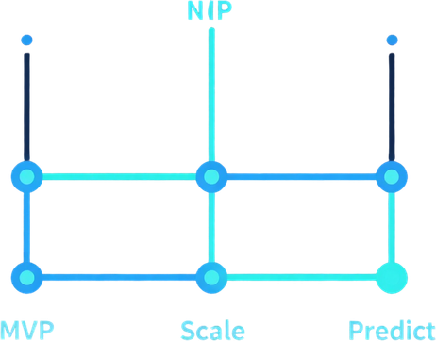
CORTEX
PAGE 09
Feasibility, Challenges & Future
✅ MVP Ready
⚠️ Challenges
🚀 Future Vision
• Working prototype built
• Python + FastAPI backend
• Sentence Transformers live
• PostgreSQL + Redis integrated
• Slack & Discord webhooks active
• Real alerts tested & filtered
• Tuning similarity thresholds
• Cold start: sparse trace data
• Dynamic service graph updates
• Balancing EWMA sensitivity
• Multi-tenant alert routing
• Scaling ingestion pipeline
• Auto-learn service topologies
• LLM-powered root cause reports
• Predictive incident forecasting
• Native OpenTelemetry collector
• SaaS deployment model
• Chaos mode stress testing
cortex-aiops.io

Slide 10

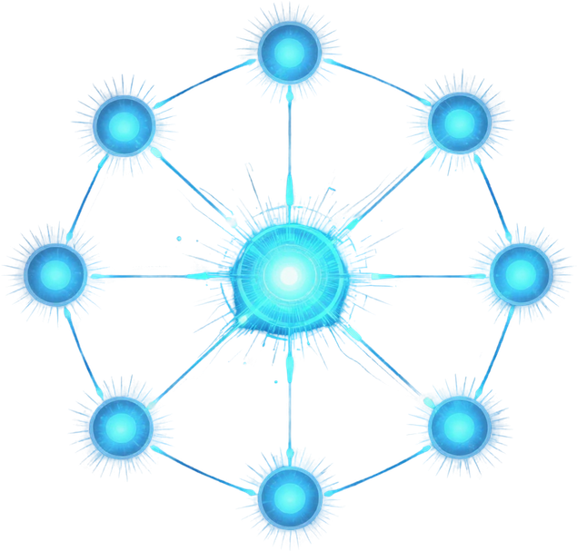



CORTEX
PAGE 10
LET'S CONNECT
github.com/cortex-aops
cortex@aiops.dev
CORTEX — Causal Incident Fabric
Not just deduplication — true causal incident intelligence.
Thank You!

